Slide 1







Web Programming 2x1
JavaScript
DOM Events

Slide 2
Outcomes
Students should understand the following outcomes, upon successful completion of this module:
JavaScript Events
Inline events
- Mouse Events
- Keyboard Events
- Form Events
- Window Events
- Touch Events
Event Listeners

Slide 3
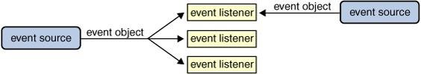
Events in JavaScript
In JavaScript, events are interactions or occurrences that happen on the web page, often initiated by the
user or the browser itself.
These events are triggered by actions like clicking a button, pressing a key, moving the mouse, submitting a form, resizing the window, and much more.
Handling these events allows developers to create dynamic and interactive web applications.
JavaScript provides the ability to detect and respond to these events, allowing you to create interactive and dynamic web applications.
Events are a fundamental part of web development because they enable you to build responsive user
interfaces and create interactions that go beyond static content.

Slide 4
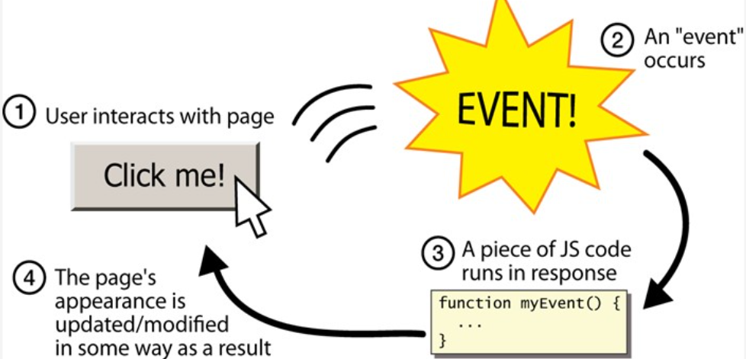
JavaScript Events
DOM events are signals exposed by the browser that you can use to run a piece of JavaScript code.
DOM Events allow JavaScript to add event listeners or event handlers to HTML elements.
When a specific DOM event happens in the browser, a piece of code will be executed as a response to that action.
These DOM events occur when the user interacts with the application we've created, such as clicking a button or typing letters into an input field.
As a web developer, you can instruct JavaScript to listen for a specific event and do something in response to that event.

Slide 5
Mouse Events
Mouse events allow you to handle user interactions involving the mouse, such as clicking, moving, or hovering over elements.
onclick: Fires when the element is clicked.
dblclick: Fires when the element is double-clicked.
mouseover: Fires when the mouse pointer is moved over the element.
mouseout: Fires when the mouse pointer leaves the element.
mousemove: Fires when the mouse pointer moves within the element.
mousedown: Fires when a mouse button is pressed down.
mouseup: Fires when a mouse button is released.

Slide 6
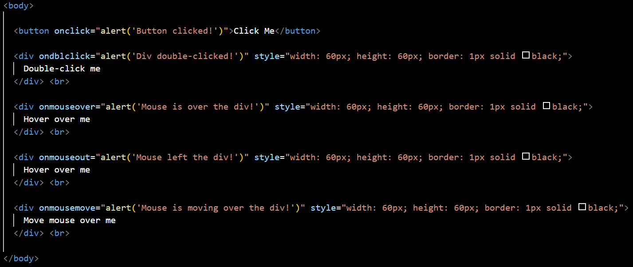
Mouse Events
Examples:

Slide 7
Keyboard Events
Keyboard events in web development are essential for creating interactive web applications.
They allow you to capture and respond to user interactions with the keyboard, such as key presses and releases.
In JavaScript, there are three primary keyboard events:
keydown: Triggered when a key is pressed down.
keyup: Triggered when a key is released.
keypress: Triggered when a key is pressed and released

Slide 8
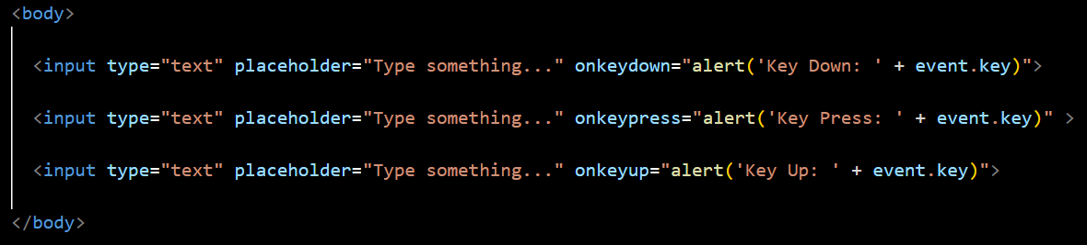
Keyboard Events
Example:
The input element has inline event handlers for keydown, keypress, and keyup events.
Each event handler uses an inline alert to display the event type and the key that was pressed or released.

Slide 9
Form Events
Form events in web development are events that occur when a user interacts with form elements like input fields, select boxes, and text areas.
Examples of form events include:
submit: Triggered when a form is submitted.
change: Triggered when the value of an input, select, or textarea element is changed.
focus: Triggered when an element gains focus.
blur: Triggered when an element loses focus.

Slide 10
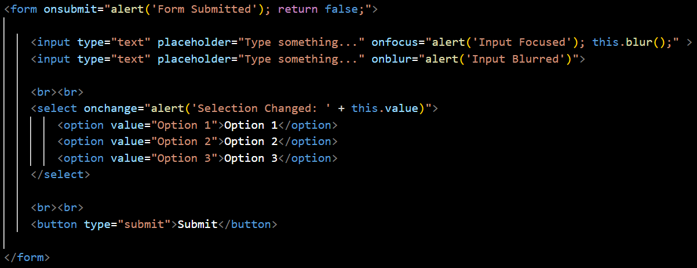
Form Events
Examples:

Slide 11
JavaScript Inline Events
Inline events are JavaScript code directly embedded within HTML tags (So far we have utilized inline events).
These are the simplest form of handling events, often used for quick and small scripts
DISADVANTAGES
ADVANTAGES
Maintenance: Harder to maintain and debug, especially as the complexity grows.
Separation of Concerns: Violates the principle of separating HTML, CSS, and JavaScript.
Scalability: Not suitable for larger applications where more complex event handling is required.
Simplicity: Easy to implement for small, simple tasks.
Quick Setup: Can be added directly within
the HTML, making it quick for prototyping.

Slide 12
Window Events
Window events in web development are events that are associated with the browser window or the document.
These events help you handle actions related to the loading and closing of the window, resizing the window, scrolling, and other interactions.
load: Triggered when the entire page, including all dependent resources, has loaded.
resize: Triggered when the window is resized.
scroll: Triggered when the window is scrolled.

Slide 13
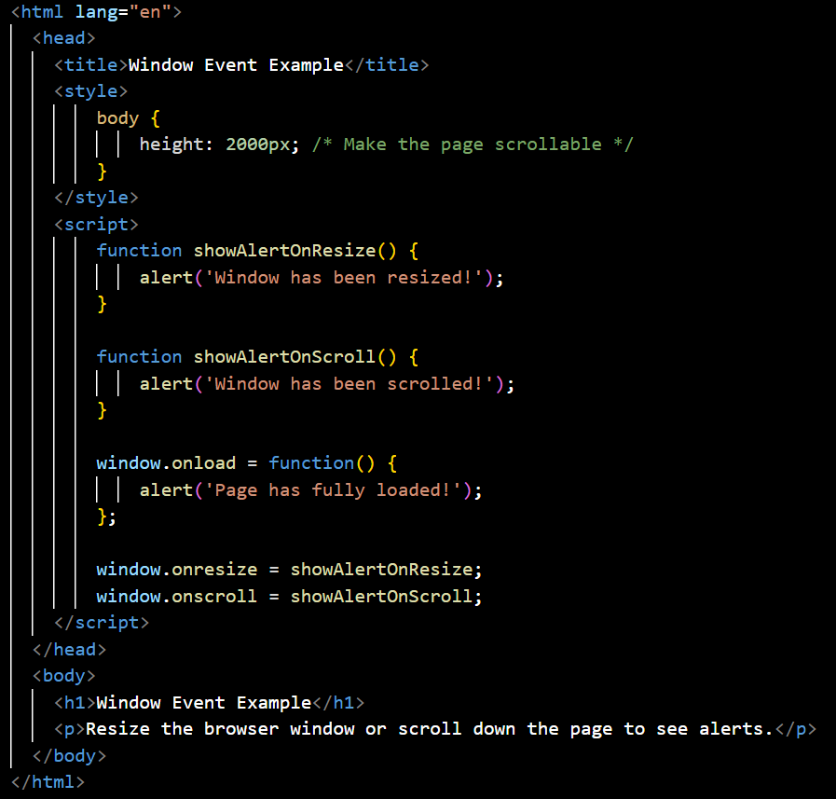
Window Events
Examples:

Slide 14
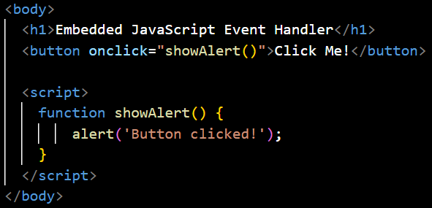
Event Handlers
Event handlers are JavaScript functions assigned to HTML elements using properties.
These handlers are defined within the JavaScript code and assigned to the elements, providing a clearer separation between HTML and JavaScript.
Example 1: use Embedded JavaScript to define event handler function:

Slide 15
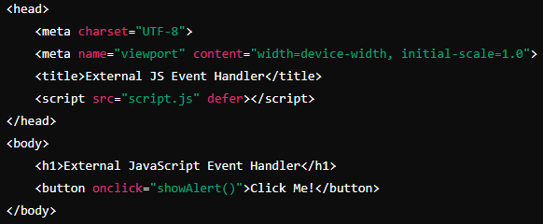

Event Handlers
Example 2: use External JavaScript to define event handler function:

Slide 16
Event Handlers
ADVANTAGES
DISADVANTAGES
Clearer Separation: Keeps HTML and JavaScript code separate, improving readability.
Reusability: Functions can be reused and reassigned
Overwriting: Assigning a new handler will overwrite the existing one, which can be limiting.

Slide 17
The `defer` Attribute
The defer attribute is used in HTML <script> tags to control the loading and execution of external JavaScript files.
Purpose of defer:
Defers Execution: When you include the defer attribute in a <script> tag, it tells the browser to delay the execution of the script until after the HTML document has been completely parsed. This ensures that the script runs only after the DOM is fully constructed.
Maintains Script Order: If you have multiple <script> tags with the defer attribute, they will be executed in the order in which they appear in the document.
Non-blocking: The defer attribute allows the browser to continue parsing the HTML document while the script is being downloaded. This avoids blocking the HTML rendering process, which can improve page load performance.

Slide 18

Event Listeners
Event listeners offer a more flexible way to handle events by using JavaScript to add event listeners to elements.
This method keeps the HTML clean and separates the JavaScript code.
We use an addEventListener() method, which can also allow multiple event handlers for the same event, without overwriting each other.
element: The HTML element to which you want to attach the event listener.
eventType: A string that specifies the type of event you want to listen for, such as "click", "keydown", "mouseover", etc.
callback: The function that will be executed when the specified event occurs.
Syntax:

Slide 19
Event Listeners
ADVANTAGES
Multiple Handlers: Allows multiple event
handlers for the same event.
Advanced Features: Supports
capturing, bubbling, and options for fine- tuning the event flow.
Cleaner Code: Encourages better code organization and separation of concerns.
DISADVANTAGES
Complexity: Slightly more complex syntax compared to inline events and event handlers.

Slide 20
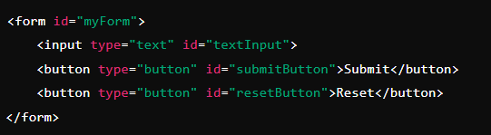
Event Listeners
You have a form with multiple buttons performing different actions. Using event listeners, you can easily manage these actions without cluttering your HTML or risking overwriting handlers.
HTML CODE:

Slide 21
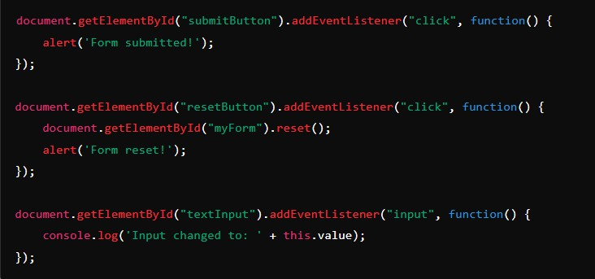

Example Continued
JavaScript CODE

Slide 22
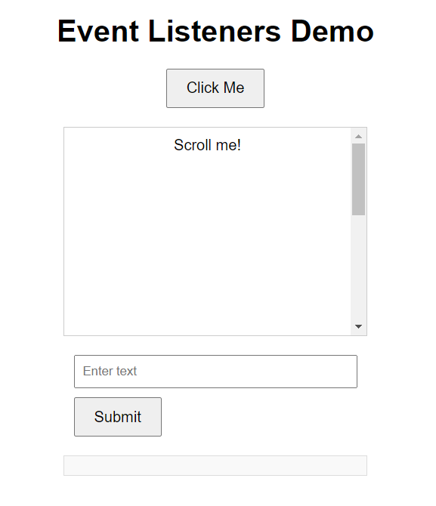
addEventListener
Example 2:
Lets create the following in HTML page:
Use the CSS file in addendum.
Create and utilise event listeners for click, mouseover, submit and resize events.

Slide 23
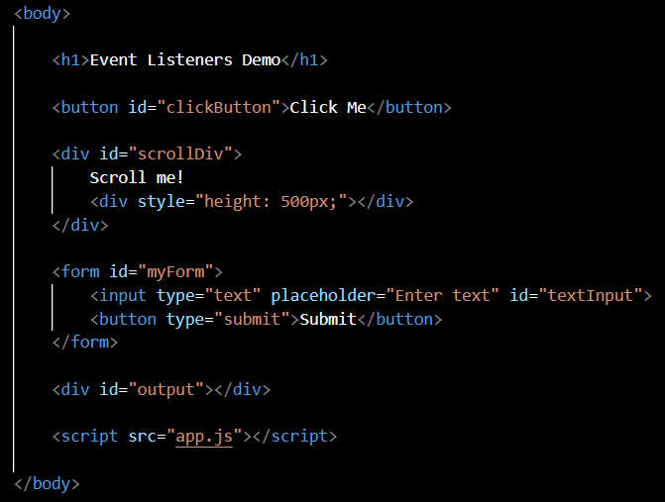
addEventListener() method
Solution:
Index.html

Slide 24
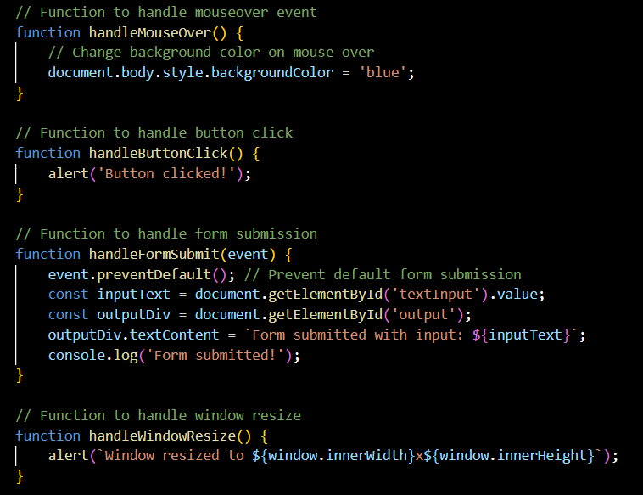
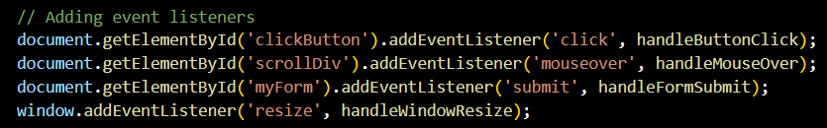
addEventListener() method
Solution:
app.js

Slide 25
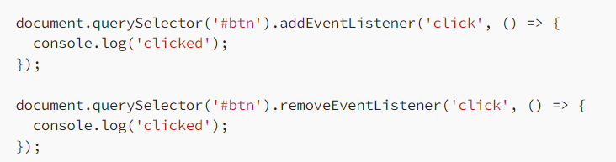
Removing event listeners
If we need to remove the event listeners, the most common way is using the removeEventListener.
It requires to follow strict parameters:
the type of listener to remove,
the same callback function for that listener

Slide 26
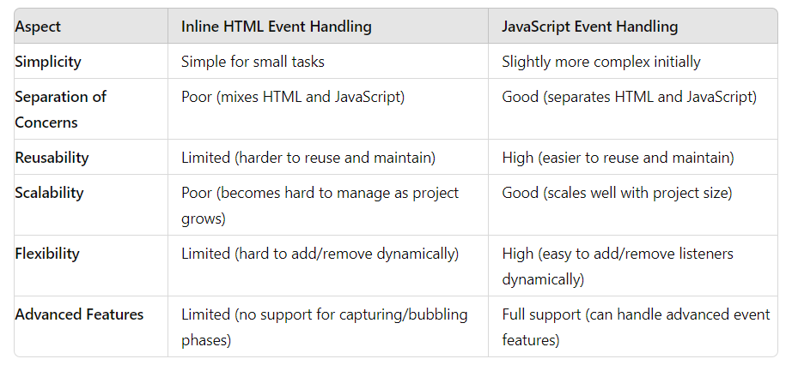
Key Differences:

Slide 27
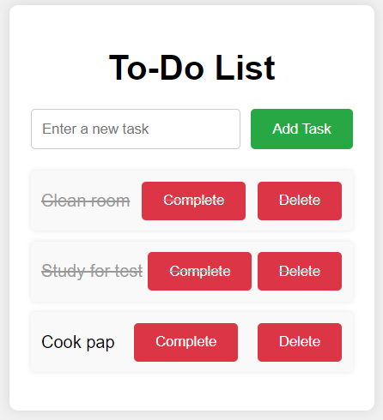
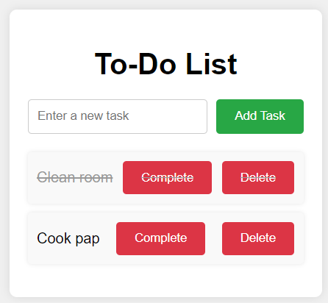
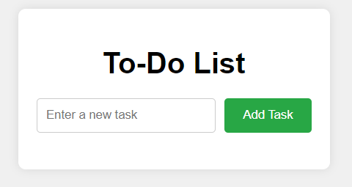
Exercise
Create a To-Do List web application that functions as shown below. A user should add tasks, mark them as complete or delete a task once complete. Use event listeners to achieve this. Addendum provided for HTML and CSS.

Slide 28
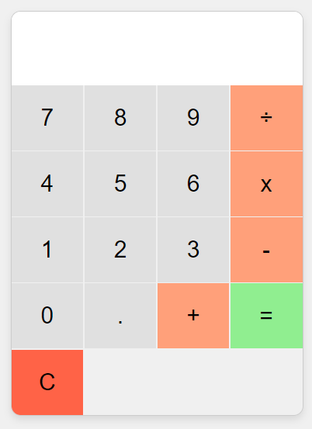
Exercise
Create a Calculator web application that functions as shown below. A user should be able to add, divide, multiply and subtract values. C should clear the display. Use event listeners to achieve this. Addendum provided for HTML and CSS.

Slide 29







Thank You!
21
THEEND
/belgiumcampusSA
#Belgium Campus
info@belgiumcampus.ac.za
+27 10 593 53 68
/belgiumcampus
www.belgiumcampus.ac.za
21

Slide 30
References
https://www.freecodecamp.org/news/here-are-the-new-built-in-methods-and-functions-in-javascript- 8f4d2fd794fa/
https://javascript.info/array-methods
https://www.tutorialrepublic.com/javascript-examples.php
https://ultimatecourses.com/blog/array-reduce-javascript

